Slide 1
Vocation Ministry

Slide 2
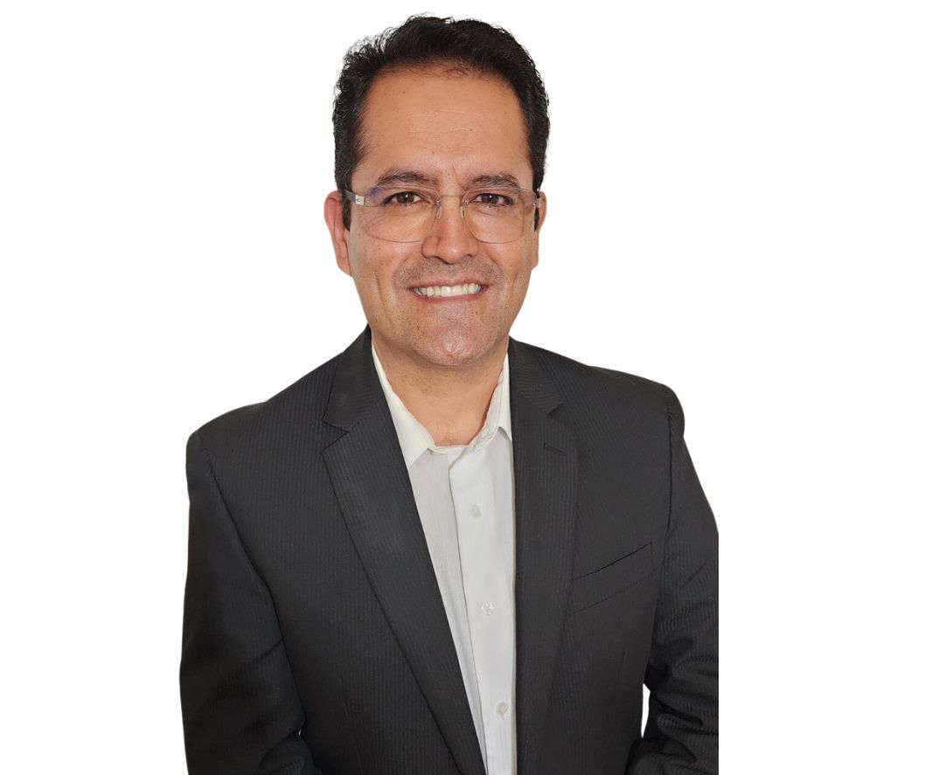
Team
Javier Reyes, CMF
Agustin Carrillo, CMF
Arturo Gonzalez

Slide 3
Forms of outreach
Social Media
Conferences
Parish Vocation Committees

Slide 4
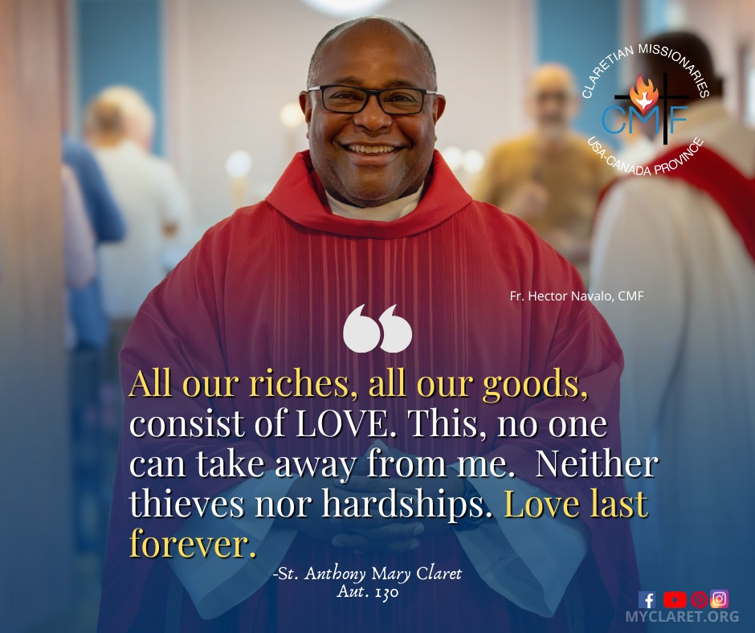
Social Media

Slide 5
Conferences
National Religious Vocation Conference (Leavenworth, KS) – July 16 - 29
Marian Days (Carthage, MO) – August 1- 4
Eucharistic Congress of the Diocese of Charlotte (Charlotte, NC) – August 30 - 31
Diocese of Fresno Congress (Visalia, CA) – October 11-13
National Religious Vocation Conference Convocation (Minneapolis, MN) – October 31 - Nov 3
National Catholic Youth Conference (Long Beach, CA) – November 14 -16
Renew Toronto (Toronto, ON) – November 23 - 24
FC+PJV (Guatemala) - November 26 - December 1
SEEK (Salt Lake, UT) – January 1- 5
RE Congress (Anaheim, CA) – February 20 - 23
Vocations Jamboree, University of Mary (Bismarck, ND) – March 18 - 20

Slide 6
Parish Vocation Committees
Visited
Perth Amboy – Our Lady of Fatima
Chicago – Our Lady of Guadalupe
Fresno – St. Anthony Claret and St. Paul
To be visited
Jersey City – St. Joseph

Slide 7
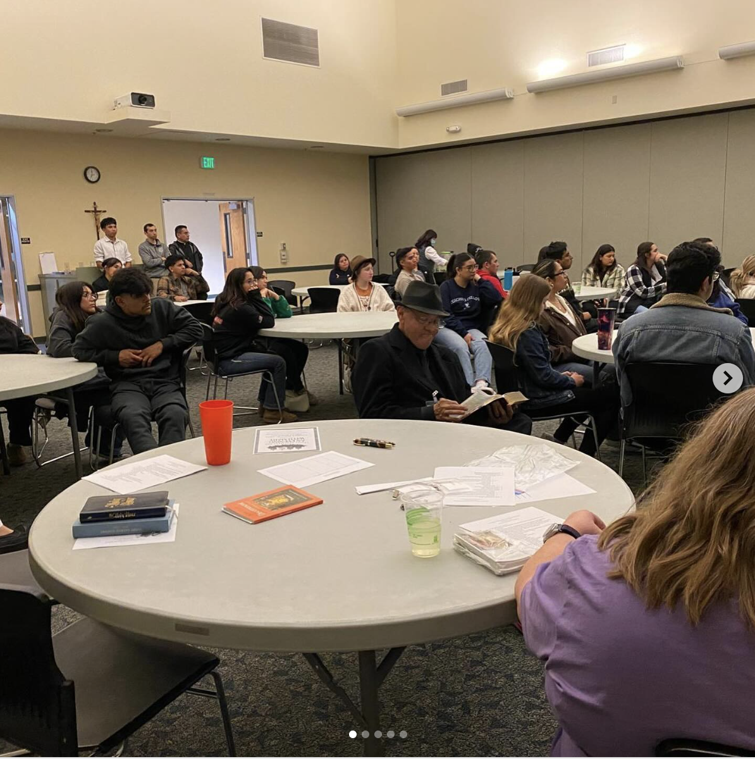
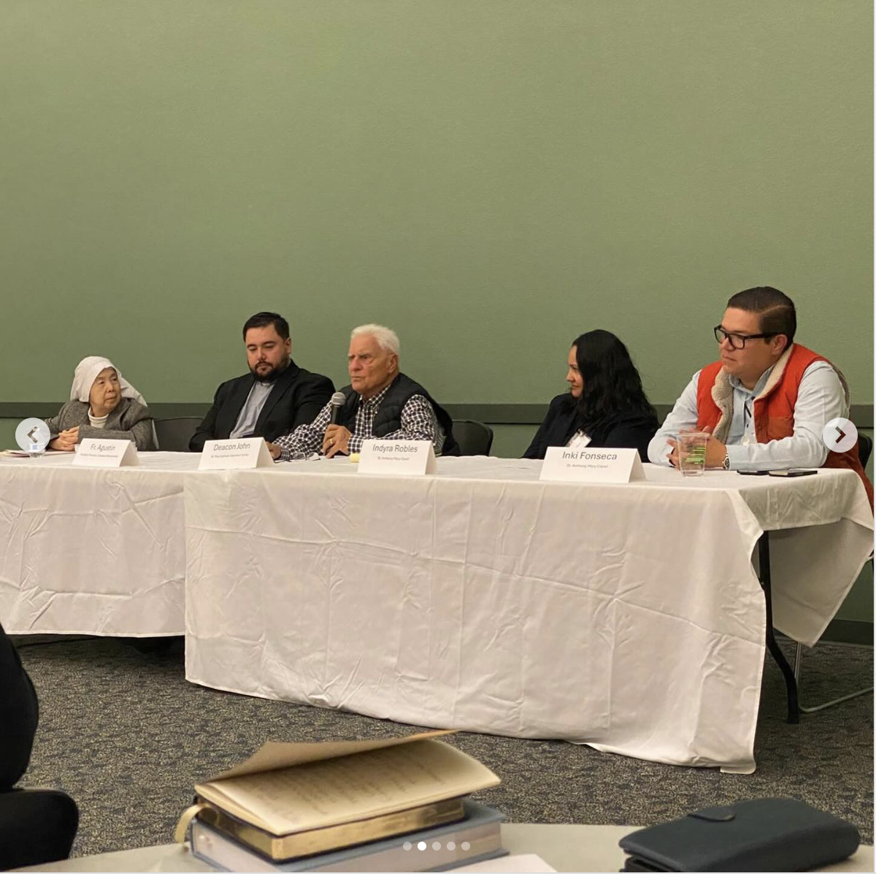
Discernment Night
November 23, 2024

Slide 8
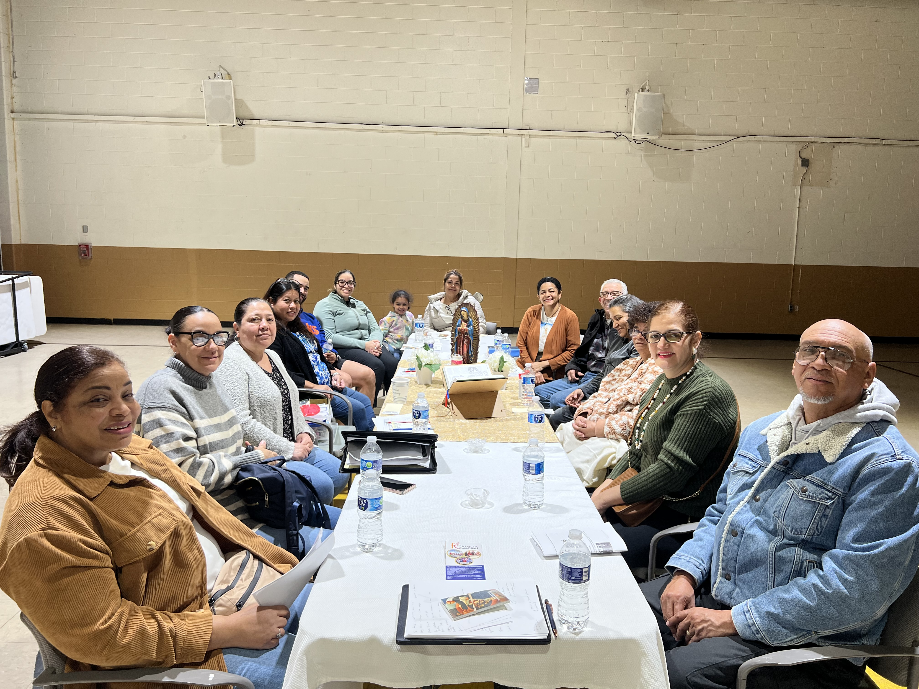
Our Lady of Fatima
March 13, 2025

Slide 9
Publications

Slide 10
Upcoming Program
June 18 – July 20 in Fresno, CA
Participants:
Mark Varghese – Toronto, ON
Benedict Lu Heng and Maxwell Turzinski
Facilitators: Agustin, CMF and Alicia Meza

Slide 11
Fresno Catholic Charities
Hinds Hospice
Vacation Bible School at St. Anthony Claret
Sierra Resource Conservation District

Slide 12
Prospects
Recently Accepted: Juan Carlos Betancourt (35)
Actively Accompanying: 2, one from Toronto and the other from Brooklyn

